Slide 1
Your Next Destination At Your Fingertips
By: Eraam Khan, Vinay Algam and Bilal Maqsood (TEAM 8)

Slide 2
Outline
Data Pre-Processing
Merging Dataset
Categorical Encoding
Random Sampling
Model Selection and Training
Model Testing
Results and Evaluation

Slide 3
Merging Dataset
We joined the following 3 datasets: “Search”, “Booking”, and “Targets”.
Used 2 “SELECT” statements to merge the above 3 datasets.
Combined the 2 “SELECT” statements using “UNION” command.
Defaultly removing duplicate rows

Slide 4
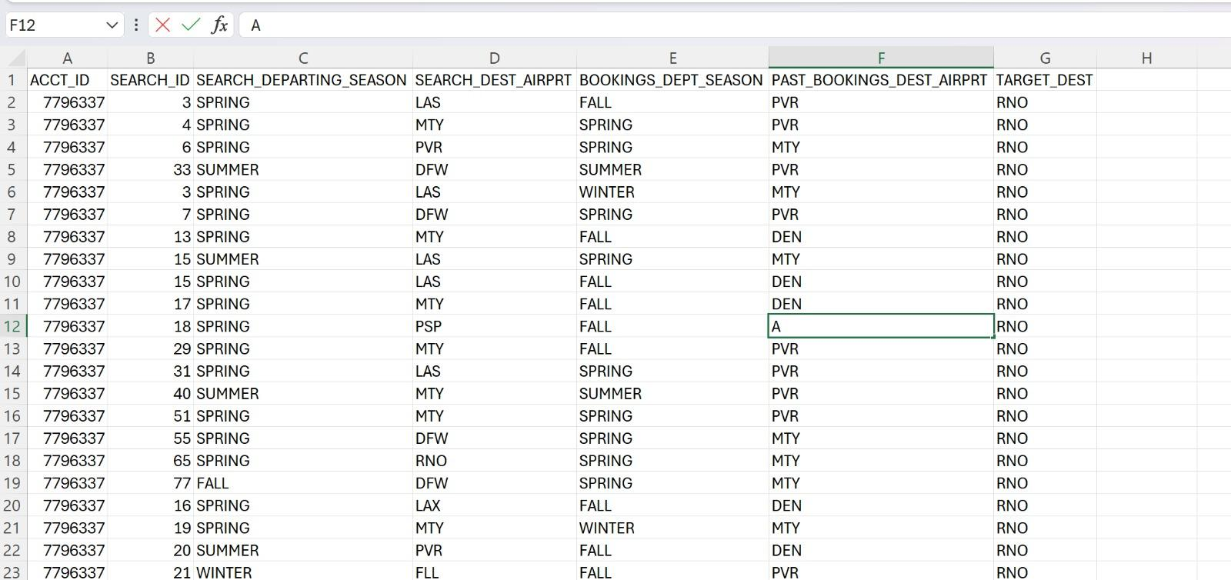

Slide 5
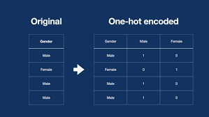
Categorical Encoding
We used “One-Hot” Encoding to encode categorical variables to numerical variables.

Slide 6
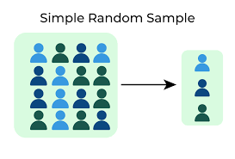
Random Sampling
We used Random Sampling to get 6000 rows from the merged dataset to get a representative sample to conduct our analysis.

Slide 7
Model Selection

Slide 8
Models in Play
We used multiple models to predict the travel destination of our customers, to analyze which model gives the best results.
Random Forest
Gradient Boosting
Logistic Regression
K-nearest Neighbour
Decision Tree

Slide 9
Model Testing and Training

Slide 10
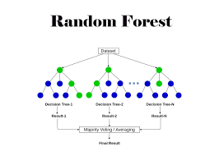
Random Forest
Using the Random Forest Model:
Accuracy: 61.3%
Precision: 60.7%
Recall: 61.3%
F1 Score: 59.5%

Slide 11
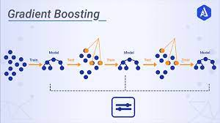
Gradient Boosting
Using the Gradient Boosting Model:
Accuracy: 54.7%
Precision: 55.3%
Recall: 54.1%
F1 Score: 53.2%

Slide 12
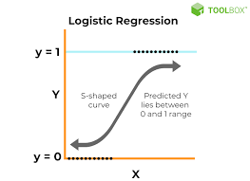
Logistic Regression
Using the Logistic Regression:
Accuracy: 53.5%
Precision: 52.4%
Recall: 53.5%
F1 Score: 50.3%

Slide 13
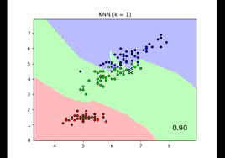
K-Nearest Neighbour
Using the KNeighbour:
Accuracy: 44.9%
Precision: 48.5%
Recall: 44.9%
F1 Score: 43.5%

Slide 14
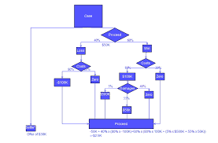
Decision Tree
Using the Decision Tree:
Accuracy: 57.9%
Precision: 59.0%
Recall: 57.8%
F1 Score: 56.8%

Slide 15
The Best Model
The best model based on the accuracy and precision scores is the Random Forest Model when considering the testing dataset. However, we were unable to test this on our test dataset due to time constraints.

